Slide 1
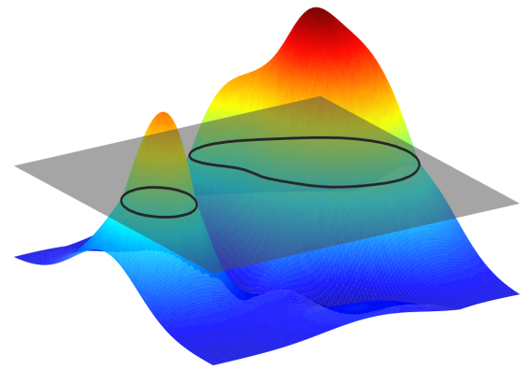
Variational methods for model-based image segmentation Applications in medical imaging
Raphael Prevost
Ph.D. Defense
21st October 2013
Medisys, Philips Research
CEREMADE, Paris Dauphine/CNRS

Slide 2
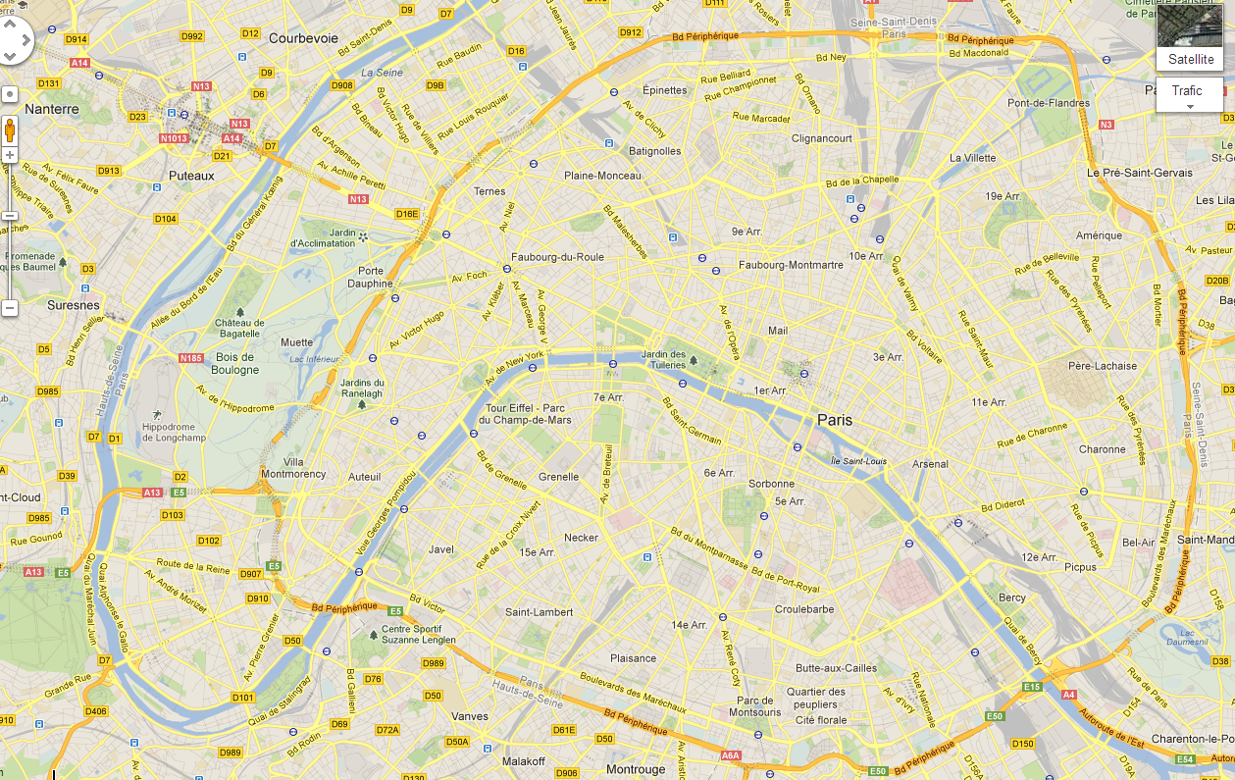
Joint work Industry/Academia
Introduction
Paris Dauphine University Ceremade
Laurent D. Cohen
Paris
Philips Research Medisys
Roberto Ardon
Benoit Mory
Remi Cuingnet
Notes:
First of all, Would like to mention that this is a joint work between industry with Philips Research and academia with the Ceremade

Slide 3
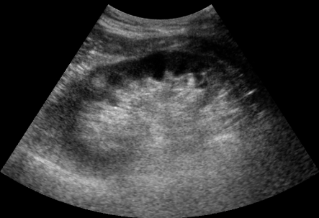
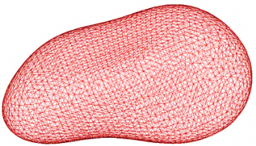
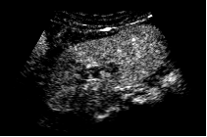
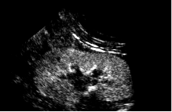
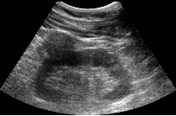
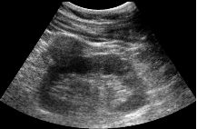
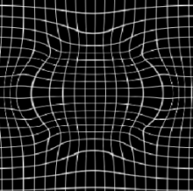
Medical images analysis – two main challenges
Introduction
Segmentation
algorithm
Registration
algorithm
Notes:
My work deals with medical imaging
Going to talk about two main problems of medical image analysis
First one segmentation, which consists in extracting the shape of an organ of interest from an image
Second one registration, which takes two images and tries to find the geometric transformation such that the two images are aligned afterwards
We will see that the two problems can be linked but we mainly focus on segmentation here

Slide 4
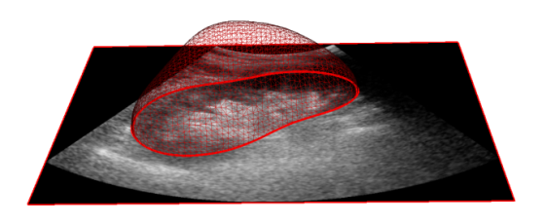
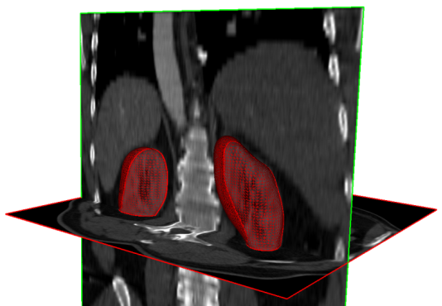
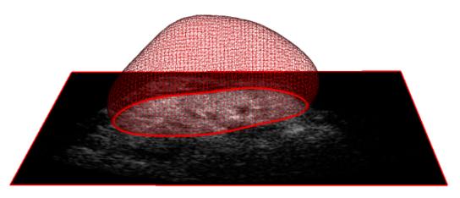
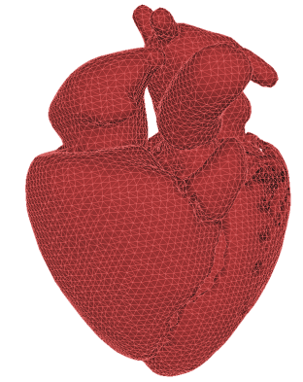
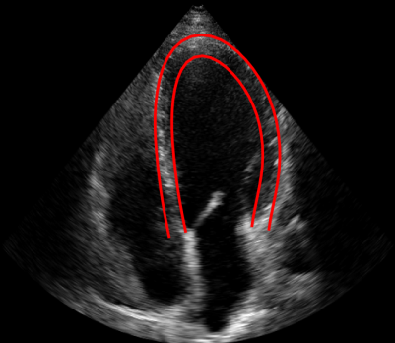
Clinical applications to be addressed
Introduction
Kidney (3D, 3D+t)
Conventional/Contrast Ultrasound
Contrast CT
Myocardium in short-axis (2D)
Myocardium in long-axis (2D)
MRI
Ultrasound
Notes:
To be more specific, the two main clinical applications addressed in this talk will be the segmentation of kidneys from 3D images
And the segmentation of 2D myocardium from 2D images, both in short axis and long axis
Interested in organs rather than blood vessels or tumours for example

Slide 5
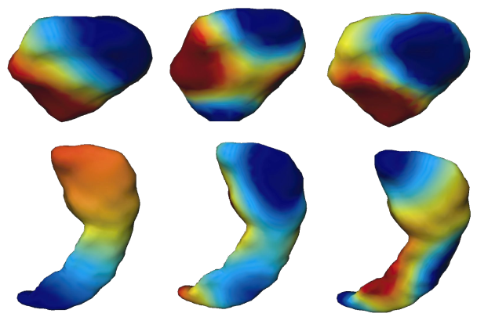
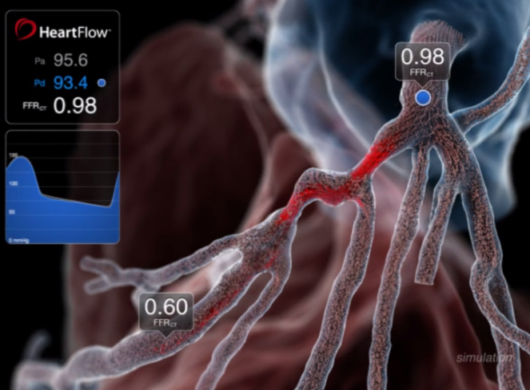
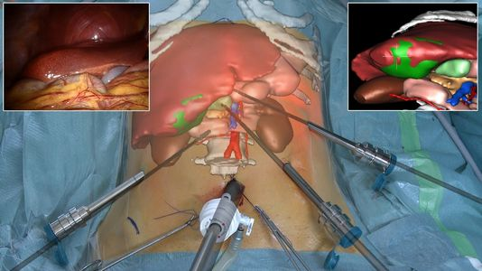
Use of segmentations in medical applications
Introduction
Volume 150 mL
Diagnosis
Statistical analysis
Patient-based simulations
Augmented reality for surgery
Notes:
Whatever the organ, there are a lot of clinical applications for segmentation algorithms
- With the segmentation of an organ, you can extract information (such as its volume) that might be useful for diagnosis
- More generally, you can perform statistical analysis on a whole population to find trends or understand better some diseases
- Another very interesting field of application is patient-specific simulations which allow for example clinicians to simulate and test the effect of a treatment
- Finally, surgeons can also use segmentation during an operation via augmented reality systems

Slide 6
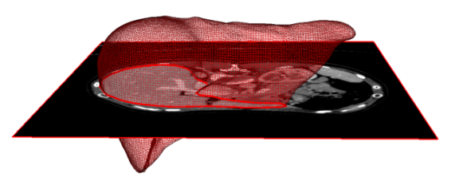
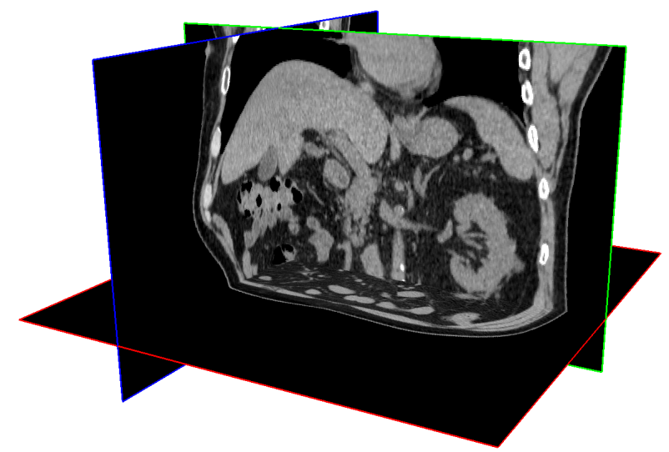
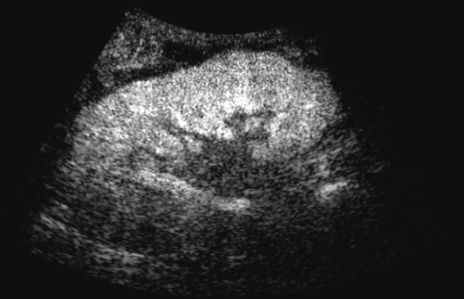
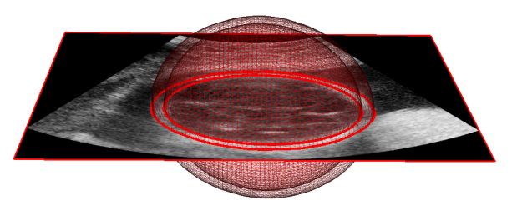
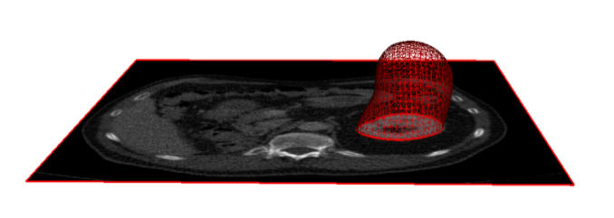
Challenges of organ segmentation
Introduction
Increasing volume of data (3D, 3D+t) → Need for efficient algorithms
Variable image quality (noise, artifacts) → Need for robust algorithms
Re-usability → Need for generic approaches
For a given organ, shape may vary but topology is often fixed
→ Need for topology control
Notes:
Unfortunately, there are a number of reasons for which segmentation of medical images is challenging
- Due to the increasing volume of data (we are dealing here with 3d or 3d+t datasets), we need efficient algorithm
Because of the sometimes poor image quality, we need robust algorithms
We also want a generic algorithm that could be applied to different organs
Finally, we would like to be able to enforce the topology of the segmentation (because organs usually have a fixed topology)

Slide 7
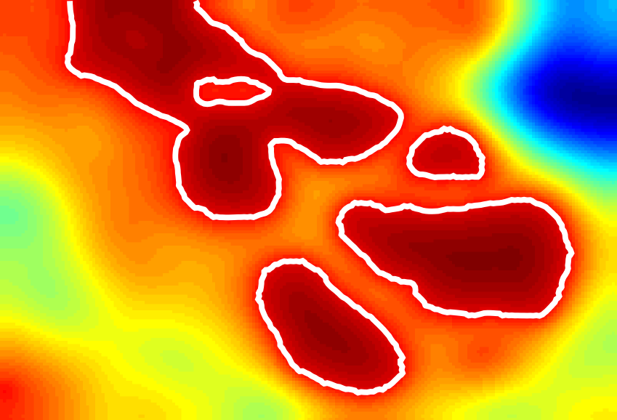
Segmentation via a hybrid method
Introduction
Level-set
segmentation [Chan & Vese, 2001]
This thesis
Atlas
deformation [Commowick et al., 2007]
Implicit Template Deformation [Mory et al., 2012]
Original image
Template
Implicit function
Segmentation
Genericity
Efficiency
Robustness
Topology control
Notes:
My thesis revolves around a hybrid algorithm between two approaches that partially meet these requirements
Implicit template deformation, which was developped in Philips, is inbetween and tries to combine those different advantages

Slide 8
Outline of the presentation
“Errors using inadequate data are much less than those using no data at all.” Charles Babbage
Part 1 - What is implicit template deformation ?
Part 2 - Application to challenging clinical problems
Part 3 - Exploiting different images of the patient
Part 4 - Learning information on shape and appearance from large databases

Slide 9
Part 1 Implicit Template Deformation Background and contributions
Shape
prior
Template
Part 2 - Applying the algorithm to challenging clinical problems
Part 3 - Exploiting different images of the patient
Part 4 - Exploiting information learnt from large databases

Slide 10
How to model the problem ?
Part 1/4 – Implicit template deformation: background and contributions
Advantages
Consistent for 2D or 3D shapes
Can efficiently represent multiple objects
No explicit parametrization required
Implicit function
Notes:
So how do we model the problem of finding this yellow shape ?
In this work, we represent shapes via implicit functions
Implicit functions are functions defined on the whole space, that are positive inside the represented shape and negative outside; the shape boundary is therefore its zero-level set
This representation has several advantages (we can use it in 2d or 3D and it can efficiently represent multiple objects)
So do we find the best implicit function phi ?

Slide 11
Segmentation via variational methods
Part 1/4 – Implicit template deformation: background and contributions
Find the segmentation in the image as
the minimum of an “energy”
Minimization by gradient descent on
Initialization
Energy
Time
Notes:
We define an energy E that depends on the image and say that the best segmentation phi* should be a minimum of this energy
To find it, we use a gradient descent approach
Start with an initialization (which is an input of the algorithm)
Let the function evolve such that it minimizes the energy in time, until we have reached a minimum point
Obviously, everything relies on the choice of the energy and the space of possible implicit functions

Slide 12
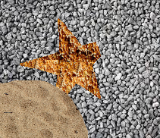
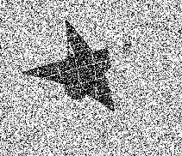
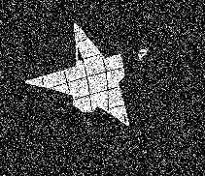
Image-based energy
Part 1/4 – Implicit template deformation: background and contributions
Implicit region competition [Chan & Vese, 2001]
Sum of the pointwise errors inside the segmentation
Regularization term
Original image
Image-based error
Desired function
Notes:
We use a region competition energy
We define at each pixel of the orginal image I an error and call this new image r_I
Phi is then found as a trade-off between having as few black pixels of r_I inside
Since r_I can be noisy or corrupted, another term enforces some regularization on phi

Slide 13
Implicit Template Deformation
Part 1/4 – Implicit template deformation: background and contributions
Implicit function = Deformation of an implicit template [Huang et al., 2004]
has a low magnitude
is a diffeomorphism
Segmentation ≈ Template
Topology preservation
Shape
prior
Template
Notes:
But key idea of template deformation is that we do not seek any function phi
If we know that is should look like a star, we can restrict phi to be a deformed version of an initial implicit function phi_0
So phi = phi_0 of psi and transformation psi becomes the unknown of the problem
Phi_0, that we call the template, acts as a shape prior if psi meets some conditions
Blabla
Those conditions are enforced with the help of the regularization term R(psi)

Slide 14
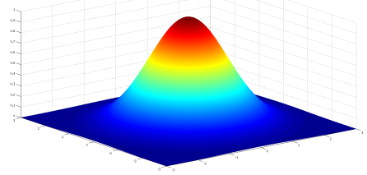
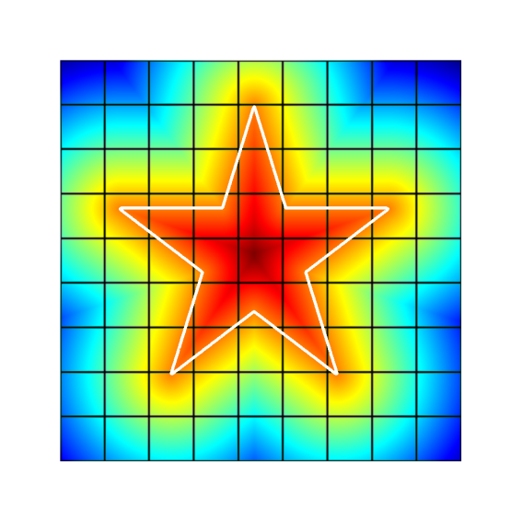
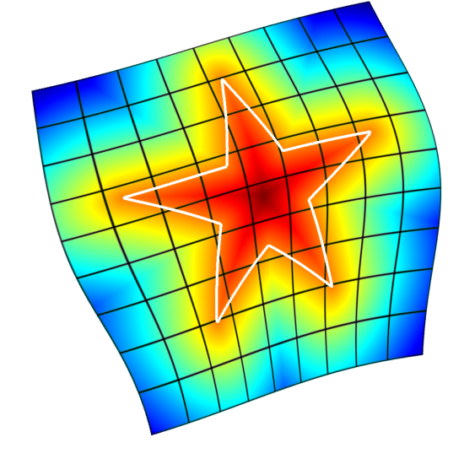
Implicit Template Deformation formulation
Part 1/4 – Implicit template deformation: background and contributions
Decomposition into a pose and a deformation [Mory et al., 2012]
Penalizes magnitude and irregularities of the deformation (pose-invariant)
Similarity
transformation
Free-Form deformation
(pose)
Notes:
In order to define this regularization term, psi is decomposed into two transformations
The first one, called G is the pose of the template within the image (just its location, scale and orientation); so it is represented by a similiarity transformation
The second transformation, L, is a free form deformation that does change the shape of the implicit function; it is defined via a displacement field u
Both transformations are optimized simultaneously but the interest of the decomposition is the possibility to define R as a function of L and therefore invariant to the pose
This term is a particular norm on the displacement field u, that is defined with a Gaussian kernel and penalizes both its magnitude and irregularities

Slide 15
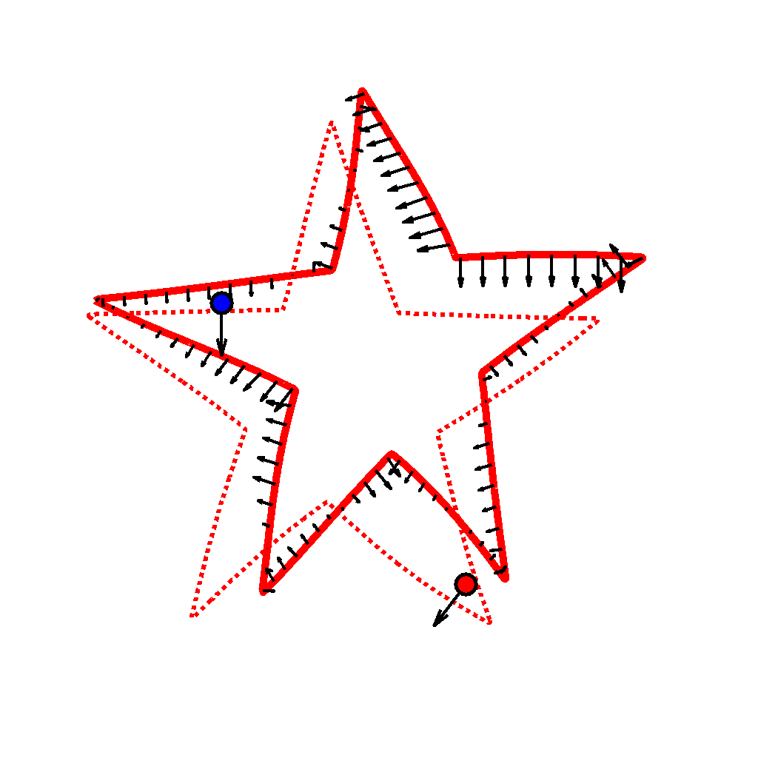
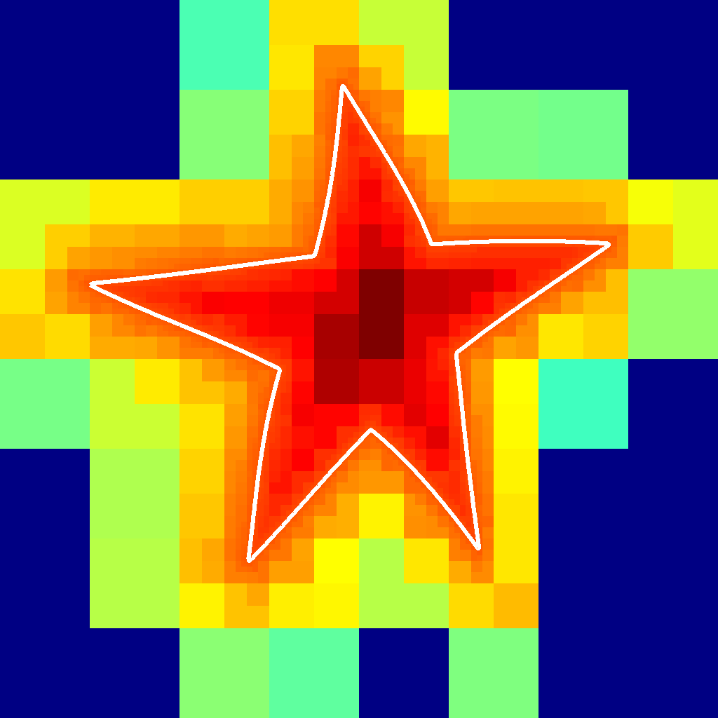
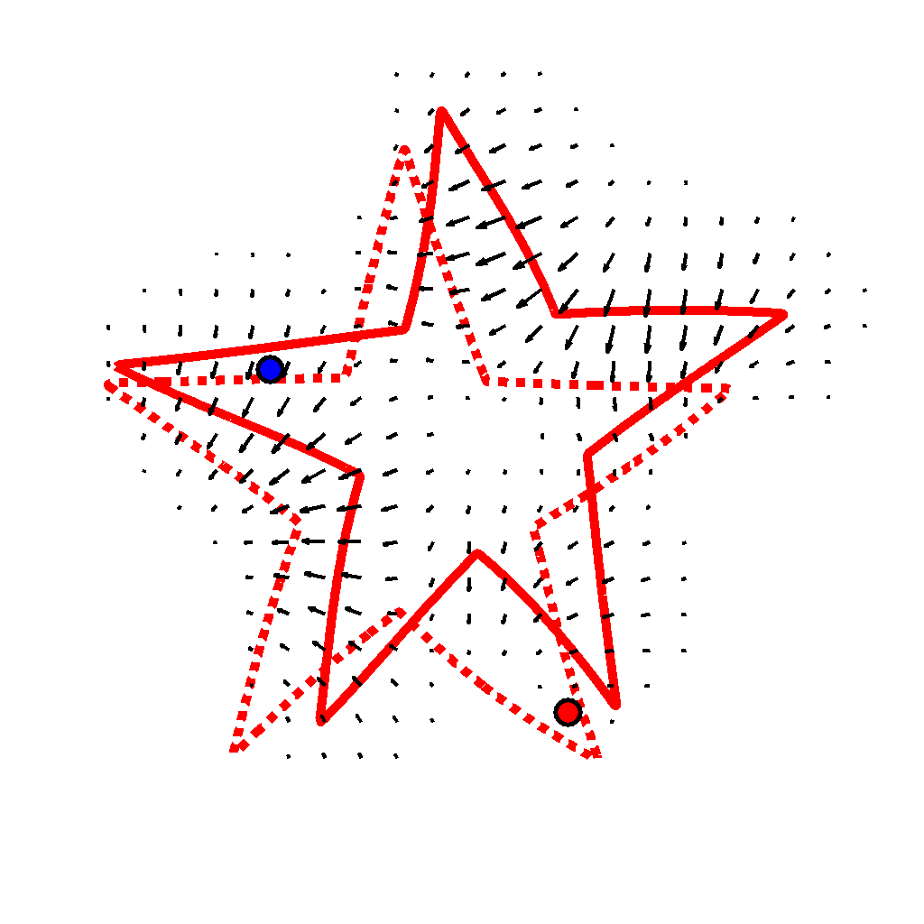
Numerical implementation
Part 1/4 – Implicit template deformation: background and contributions
Gradient descent equations
Sparse contributions
Octree implicit function
Diffusion by
linear filtering
Very efficient algorithm (a few seconds in 3D)
Notes:
With this model, the gradient equations can be computed efficiently
These Diracs show that we need to perform computations only at the boundary of the current segmentation
Such points can be found quickly with an octree implementation of the implicit function
Finally, forces are diffused everywhere with the Gaussian convolution that is also performed efficiently
In the end, the algorithm is very efficient, ie a few seconds in 3D

Slide 16
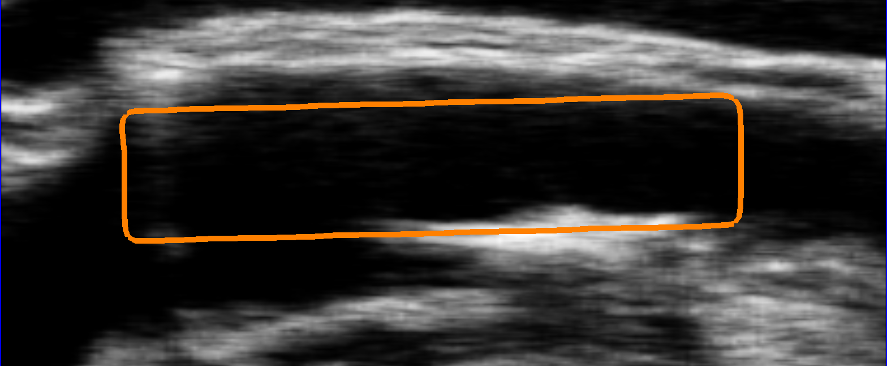
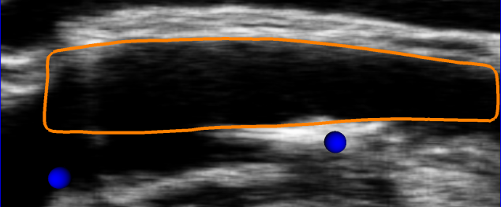
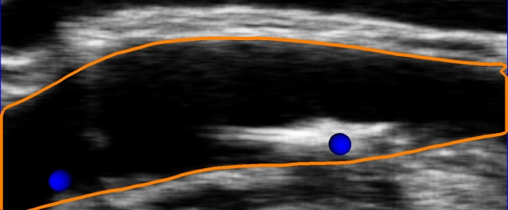
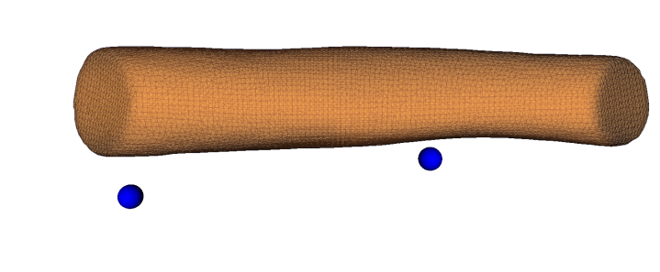
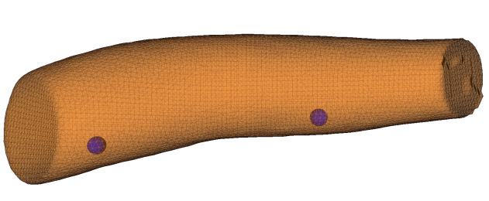
Incorporating user interactions
Part 1/4 – Implicit template deformation: background and contributions
Initialization
Incorrect segmentation → user interactions
Constrained
segmentation
Benefit of the implicit formulation interactions = inequality constraints [Mory et al., 2012]
+1/-1 for inside/outside points
Point clicked by the user
Notes:
But the other great thing about this approach is the ability to take into account user interactions
Imagine you want to segment this image; even if the algorithm fails, you can help him by clicking on points that should be inside the segmentation
Mathematically speaking, you just have to add some constraints on the sign of the implicit function
When you solve the constrained optimization, you obtain a better segmentation

Slide 17
Contributions around the algorithm
Part 1/4 – Implicit template deformation: background and contributions
Initialization
Image-based error
Learning from a database
Implicit Template Deformation
User
interactions
Other images of the patient
Incorporate additional info without losing the advantages:
efficiency, topology control and compatibility with user interactions
Notes:
So ITD appears as a very interesting framework for segmentation, which is why it was at the center of my work
No matter how sophisticated your algorithm is, at the end, the most important thing is what information you give it
General line of thought: feed as much information as possible
Init (non convex)

Slide 18
Part 2 Application to challenging clinical problems Kidney segmentation in ultrasound images
Part 1 - Implicit template deformation: background & contributions
Contrast-Enhanced Ultrasound (CEUS)
Conventional Ultrasound (US)
Part 3 - Exploiting different images of the patient
Part 4 - Exploiting information learnt from large databases

Slide 19
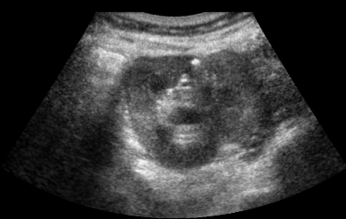
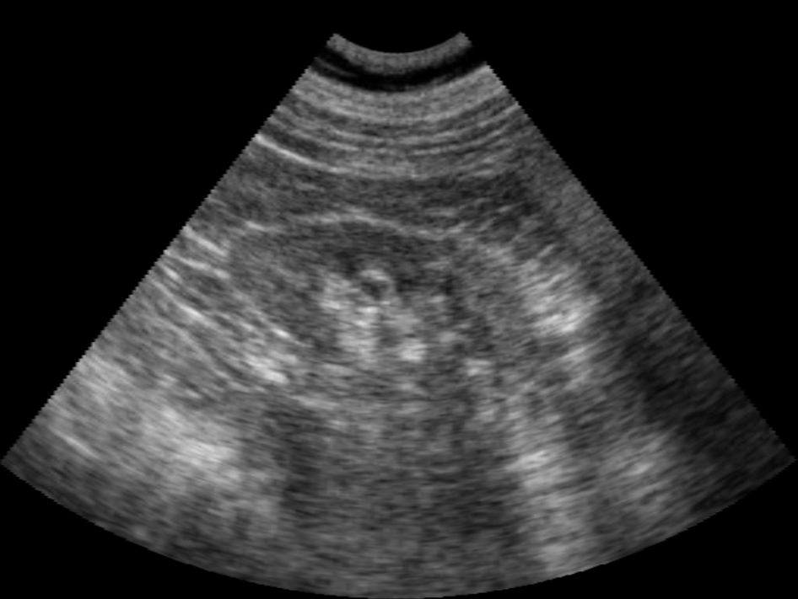
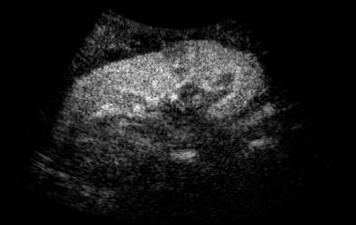
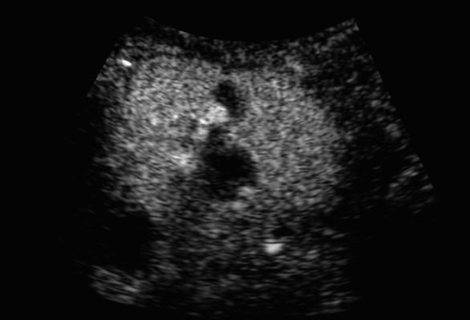
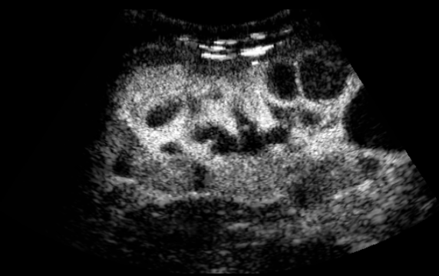
Kidney segmentation in ultrasound images
Part 2/4 – Application to kidney segmentation in ultrasound images
Conventional B-Mode Ultrasound (US)
Contrast-Enhanced Ultrasound (CEUS)
No automatic method reported in the literature
Notes:
CEUS: better visualization of lesions

Slide 20
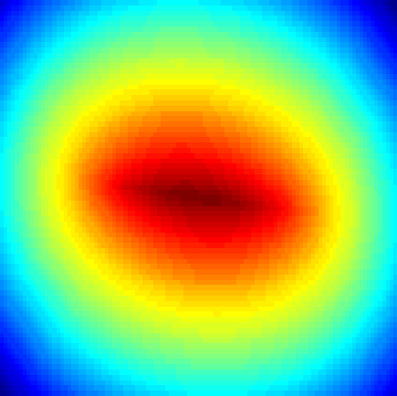
Detecting the kidney in CEUS images
Part 2/4 – Application to kidney segmentation in ultrasound images
The template is detected as a bright ellipsoid on a dark background Noise, neighboring structures → Robustness required
Hough transform [McLaughlin, 1998]→ High computational time in 3D
Robust ellipsoid estimation
an implicit function parametrized by
a centre and a positive definite matrix
a weighting function that indicates the confidence in each pixel

Slide 21
A variational approach for ellipsoid estimation
Part 2/4 – Application to kidney segmentation in ultrasound images
Data term
Pixels with high intensity should be included.
Each contribution is weighted by .
Regularization
Penalizes the ellipsoid’s volume
log → statistical interpretation
Normalization factor

Slide 22
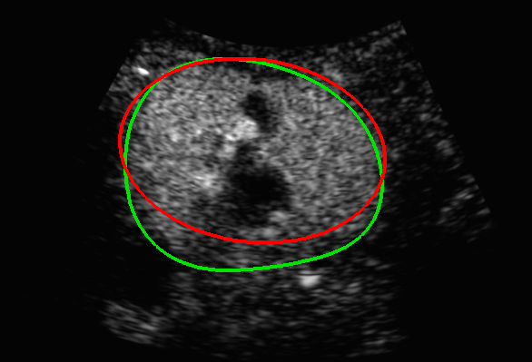
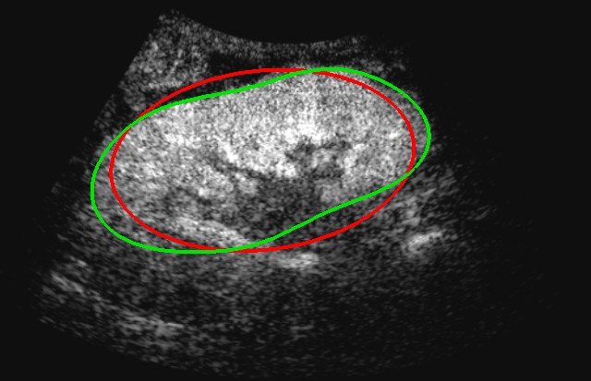
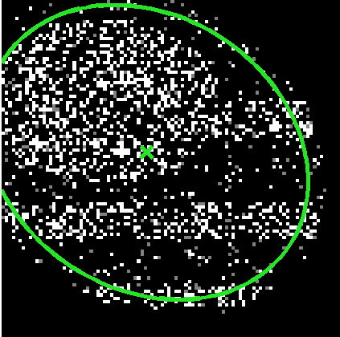
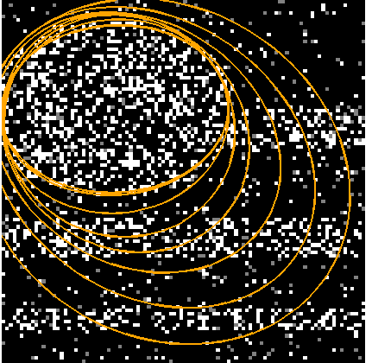
Algorithm for robust ellipsoid estimation
Part 2/4 – Application to kidney segmentation in ultrasound images
Closed-form solutions → Simple alternate optimization
repeat
estimation of ellipsoid with weighted barycenter / covariance matrix
estimation of confidence weights based on the current ellipsoid estimate
until convergence
Synthetic image
1st iteration
Evolution
Final result

Slide 23
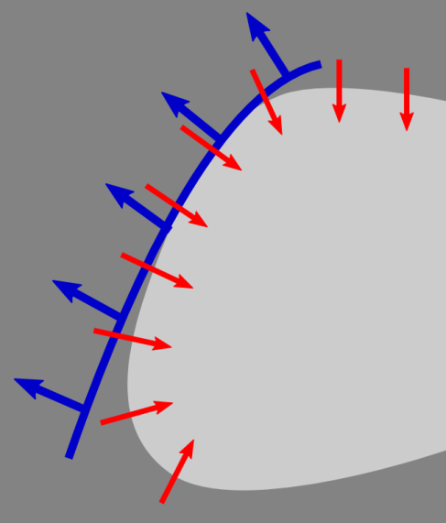
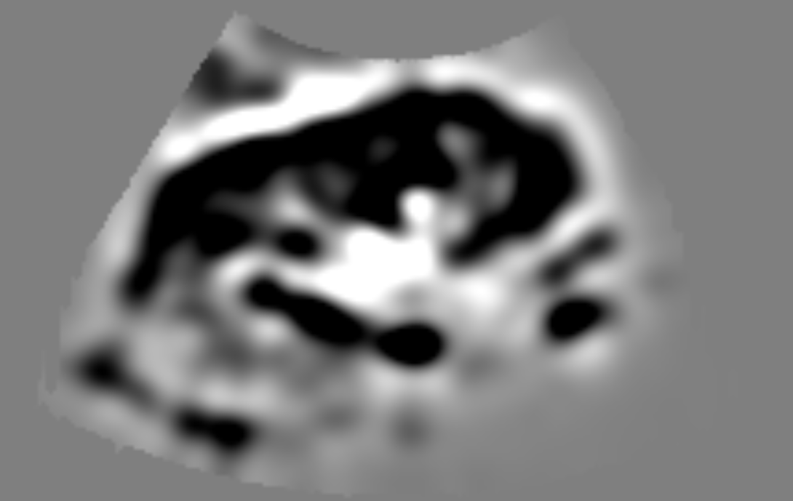
Choosing the image-based error as the Laplacian
Part 2/4 – Application to kidney segmentation in ultrasound images
Minimize the image gradient flux
through the segmentation boundary
(Green-Ostrogradski)

Slide 24
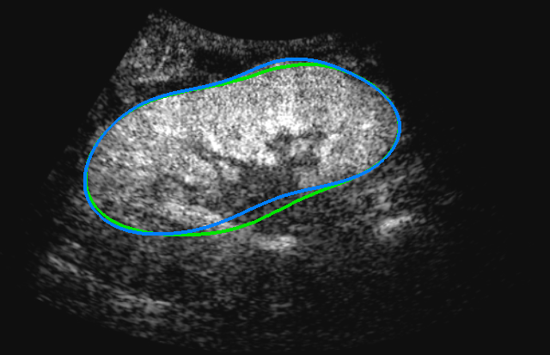
Results of kidney segmentation in CEUS images
Part 2/4 – Application to kidney segmentation in ultrasound images
Ellipsoid vs Ground truth
Segmentation vs Ground truth
Validation
64 images from 35 patients
Both healthy subjects and patients with pathologies
Computational time:
5 sec / image
Median 0.69
Median 0.76
(Very few user interactions are enough to yield Dice coefficients > 0.9)

Slide 25
What about conventional US images ?
Part 2/4 – Application to kidney segmentation in ultrasound images
Contrast-enhanced ultrasound
Conventional ultrasound
Need to transform the US image in a kidney probability map

Slide 26
Learning with auto-context Random Forests
Part 2/4 – Application to kidney segmentation in ultrasound images
Each pixel is classified kidney/background by random forest classification [Breiman, 2001; Criminisi et al., 2011]: fast, non linear
Image features: intensity and Laplacian in the voxel and in its neighborhood
Iterative estimation (auto-context) to bring spatial consistency and structural information, similarly to [Tu et al., 2010]
Original
image
First estimate of probability
Improved probability

Slide 27
Results of kidney segmentation in US images
Part 2/4 – Application to kidney segmentation in ultrasound images
Ellipsoid vs Segmentation vs Ground truth
Validation
64 images from 35 patients
Both healthy subjects and patients with pathologies
Computational time:
15 sec / image
Median 0.63
Median 0.73

Slide 28
Contributions (Part 2)
Part 2/4 – Application to kidney segmentation in ultrasound images
Showed the potential of implicit template deformation in challenging clinical problems (validation on significant databases)
Introduced a novel variational method for robust ellipsoid estimation
Improved probability maps using auto-context random forests
R. Cuingnet, R. Prevost, B. Mory, D. Lesage, L.D. Cohen, R. Ardon."Automatic Detection and Segmentation of Kidneys in 3D CT Images Using Random Forests", MICCAI 2012
R. Prevost, B. Mory, J.-M. Correas, L.D. Cohen, R. Ardon. "Kidney detection and real-time segmentation in 3D contrast-enhanced ultrasound images", ISBI 2012
R. Prevost, R. Cuingnet, B. Mory, J.-M. Correas, L.D. Cohen, R. Ardon. "Joint Co-Segmentation and Registration of 3D Ultrasound Images“, IPMI 2013

Slide 29
Part 3 Exploiting different images of the patient A joint co-segmentation and registration approach
Part 1 - Implicit template deformation: background & contributions
Part 2 - Applying the algorithm to challenging clinical problems
Part 4 - Exploiting information learnt from large databases

Slide 30
Using simultaneously US and CEUS
Part 3/4 – Using multiple images via joint co-segmentation and registration
CEUS image
US image
- Both images must be aligned if used simultaneously → Registration helps co-segmentation
- Iconic registration difficult Feature-based registration only possible with kidney boundary
→ Co-segmentation helps registration
Joint co-segmentation and registration

Slide 31
Joint Co-Segmentation and Registration
Part 3/4 – Using multiple images via joint co-segmentation and registration
Joint Co-Segmentation and Registration
CEUS image
US image

Slide 32
Generic Framework for Co-Segmentation
Part 3/4 – Using multiple images via joint co-segmentation and registration
Consider any variational algorithm that minimizes the energy
We can easily extend it to several images (if they are registered)
The object’s movement between the two images is modeled by
a global transformation as in [Yezzi et al., 2003]

Slide 33
Generic Framework for Co-Segmentation
Part 3/4 – Using multiple images via joint co-segmentation and registration
Assumption (holds for kidney) The organ may move and rotate but not deform.
We constrain to be a rigid transformation.
Co-Segmentation
Registration

Slide 34
Application to two algorithms
Part 3/4 – Using multiple images via joint co-segmentation and registration
The generic approach for co-segmentation can be applied to both
the robust ellipsoid detection and implicit template deformation
initialization

Slide 35
Example of kidney co-segmentation in US/CEUS
Part 3/4 – Using multiple images via joint co-segmentation and registration
Independent segmentation vs Co-segmentation vs Ground truth
Notes:
Shadow very frequent artifact

Slide 36
Quantitative validation (Kidney in US/CEUS)
Part 3/4 – Using multiple images via joint co-segmentation and registration
Validation
64 pair of images from 35 patients
Two-fold cross validation
Computational time:
20 sec / pair of images
Segmentation improvement statistically significant
p-value < 1e-4 for the Wilcoxon signed-rank test
Error on the measured renal volume divided by 2

Slide 37
Another clinical application for co-segmentation
Part 3/4 – Using multiple images via joint co-segmentation and registration
Perfusion CT
Acquisition of a temporal series of volumes (3D+T)
Injection of a contrast agent
Study of contrast diffusion in the image
At every pixel, the intensity is studied as a function of time
Useful for diagnosis
Problem
The volumes are not aligned (breathing, patients movements)

Slide 38
Sequence stabilization via co-segmentation
Part 3/4 – Using multiple images via joint co-segmentation and registration
Approach Register the images in a region of interest around the kidney based on its co-segmentation
Co-segmentation and registration of any number of images
Notes:
Whole kidney does not fit in a single frame

Slide 39
Kidney co-segmentation in a sequence
Part 3/4 – Using multiple images via joint co-segmentation and registration

Slide 40
A sequence before and after stabilization
Part 3/4 – Using multiple images via joint co-segmentation and registration
Original sequence
(before stabilization)
Processed sequence
(after stabilization)

Slide 41
Quantitative validation (Kidney in Perfusion CT)
Part 3/4 – Using multiple images via joint co-segmentation and registration
Validation
15 sequences from 6 patients
66 volumes per sequence
Computational time: 30 sec / sequence
Comparison with state-of-the-art [Romain et al., 2012]

Slide 42
Improvements in terms of parametric images
Part 3/4 – Using multiple images via joint co-segmentation and registration
Better registrations yield better estimation of parameters
Parametric image
with block-matching
stabilization
Parametric image
with proposed stabilization
Notes:
Much more visible, parameter estimation more reliable, therefore make the correct diagnosis

Slide 43
Contributions (Part 3)
Part 3/4 – Using multiple images via joint co-segmentation and registration
We described a generic approach for joint co-segmentation and registration
Application to two different algorithms: robust ellipsoid detection and implicit template deformation
Extension to any number of images for organ tracking and sequence stabilization
Improvements over state-of-the-art in the two studied applications
R. Prevost, R. Cuingnet, B. Mory, J.-M. Correas, L.D. Cohen, R. Ardon. "Joint Co-Segmentation and Registration of 3D Ultrasound Images“, IPMI 2013
R. Prevost, B. Romain, B. Mory, O. Lucidarme, R. Cuingnet, L.D. Cohen, R. Ardon. "Registration of 3D+T Abdominal Perfusion CT Images via Co-Segmentation “, MICCAI 2013
Two industrial patents filed

Slide 44
Part 4 Exploiting shape information from databases Learning the best template and shape variability
Part 1 - Implicit template deformation: background & contributions
Part 2 - Applying the algorithm to challenging clinical problems
Part 3 - Exploiting different images of the patient

Slide 45
Improving segmentation via shape learning
Part 4/4 – Learning information from large databases
1
Find the best implicit template to be deformed
→ Dedicated estimation of a mean model [Joshi et al., 2004]
Learn the shape variability
→ Main modes of variation around the mean
Exploit this information for future segmentations while maintaining both efficiency and topology preservation
2
3
Stats on
implicit
functions [Tsai et al.,
2003]
Database of pre-segmented shapes
Notes:
Tsai: Stat analysis on implicit functions (mean and PCA modes)

Slide 46
A tailored definition of the mean shape
Part 4/4 – Learning information from large databases
Generic definition of a mean [Frechet et al., 1948]
Shape representation
“Distance” between shapes
Implicit functions with a fixed topology, given by a prior template
Energy of implicit template deformation (only a pre-metric)
Template
Data term

Slide 47
Learning via co-segmentation
Part 4/4 – Learning information from large databases
Pre-segmented
shapes
3 kinds of variables
to optimize
Poses
Common deformation
Residual deformations

Slide 48
Learning further information
Part 4/4 – Learning information from large databases
We know how to compute a mean.
But what about the variability around this mean ?
PCA on the residual deformations
Mean
Modes
Space of main deformations [Rueckert et al.,
2001]

Slide 49
Exploiting the shape variability via PCA modes
Part 4/4 – Learning information from large databases
High number of modes needed to be precise
User interactions more difficult
is not always a diffeomorphism
Incorporate the combination of modes
within the regularization
Only the deformations that cannot be explained by the first modes are penalized
can still be enforced to be diffeomorphic

Slide 50
A generalized segmentation algorithm
Part 4/4 – Learning information from large databases
Alternate minimization
Closed-form solution
Same as standard algorithm (via gradient descent)
No additional cost
Negligible overhead
Composition update to guarantee diffeomorphism [Saddi et al., 2007]

Slide 51
Evaluation of myocardium segmentation in MR
Part 4/4 – Learning information from large databases
Database 245 short-axis 2D MRI from 61 patients
2-fold cross validation Training: 30 patients Test: 31 patients
Statistically significant improvements
Dice coefficient

Slide 52
Some visual results
Part 4/4 – Learning information from large databases
Deformation of
No modes
Low constraint
No modes High constraint
With modes
(proposed)
Case
#1
Case
#2
Case
#3
Segmentation result vs Ground truth

Slide 53
Contributions (Part 4)
Part 4/4 – Learning information from large databases
We presented a method to learn and exploit shape variability in the implicit template deformation framework
Learning: automatic (no landmarks) and unbiased (w.r.t. initial template or global pre-alignment)
Segmentation: efficient (a few seconds in 3D), robust and preserves topology
Moving to 3D applications, e.g. liver
R. Prevost, B. Mory, R. Cuingnet, L.D. Cohen, R. Ardon. "Incorporating Shape Variability in Image Segmentation by Implicit Template Deformation“, MICCAI 2013

Slide 54
A brief look at tagged templates Learning local appearance from databases

Slide 55
Myocardium segmentation in 2D US images
Part 4/4 – Learning information from large databases
Myocardium appearance cannot be defined globally...
… but it is consistent across subjects.
This information should be added to the model

Slide 56
Tagged templates
Part 4/4 – Learning information from large databases
-1
+1
+1
Generalization of the image-based energy with tagged template
Tag function (defined within the template)

Slide 57
Learning the tag function
Part 4/4 – Learning information from large databases
Database of registered images
Learnt tag

Slide 58
Evaluation of myocardium segmentation in US
Part 4/4 – Learning information from large databases
Segmentation (no tags) vs Ground truth
Segmentation (tags) vs Ground truth
Validation
 | Dice coefficient | Mean distance (mm) | Maximum Distance (mm)
Segmentation with standard template | 0,59 | 5,10 | 16,65
Segmentation with tagged template | 0,77 | 3,15 | 9,76
42 images from 14 patients
Leave-one-out validation
Ground truth provided by a cardiologist
Segmentation with tagged implicit template deformation
vs Ground truth

Slide 59
General conclusion
We applied implicit template deformation in challenging clinical applications (validation on significant databases)
We presented an approach to use multiple images simultaneously within this framework (and other ones)
We turned the initial algorithm into a complete and powerful framework that is
able to leverage learnt information on shape or appearance
both efficient and topology-preserving
All contributions are compatible and complementary

Slide 60
Perspectives
Aneurysm in US / CEUS images
Tagged co-segmentation
Use tags to define what parts of the model should be using which image
Towards multi-organ segmentation
Implicit functions can represent multiple objects; with tagged models we can also use different image features
Vessel wall
Lumen

Slide 61
Thank you for your attention !

